Slide 1
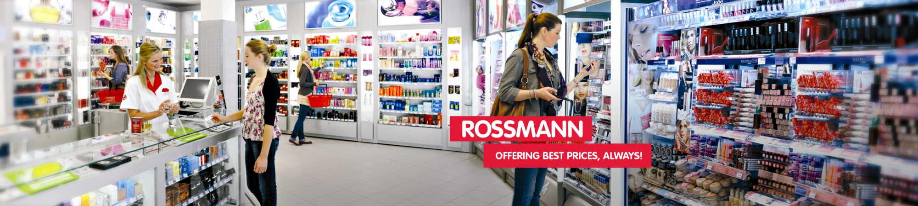
Pharmaceutical Sales prediction across multiple stores
Empowering Data-Driven Decision Making

Slide 2
Introduction
Sales forecasting is the process of estimating future revenue by predicting the amount of product or services a sales unit will sell in the next week, month, quarter, or year.
Rossmann Store managers are tasked with predicting their daily sales for up to six weeks in advance.
Identified factors such as promotions, competition, school and state holidays, seasonality, and locality as necessary for predicting sales across the various stores.
Exploration of the data encapsulates checking all available features, checking their interactions and correlation as well as their variability with respect to the target.
Our goal is to check how some measures such as promos and opening of new stores affect purchasing behavior.
The objective of this project is to build and serve an end-to-end product that delivers this prediction to analysts in the finance team.

Slide 3
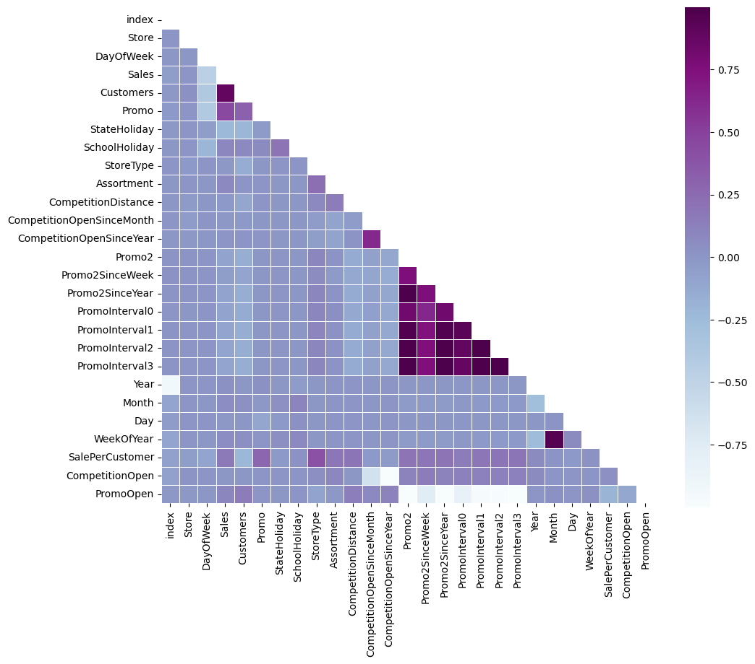
Correlation of variables with each other
we have a strong positive correlation between the amount of Sales and Customers of a store. We can also observe a positive correlation between the fact that the store had a running promotion (Promo equal to 1) and amount of Customers.

Slide 4
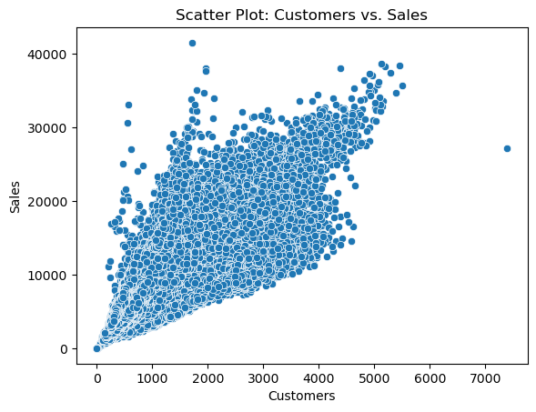
Correlation between Sales and number of customers
In the scatter plot, we observe a clear upward trend, it supports the positive correlation.

Slide 5
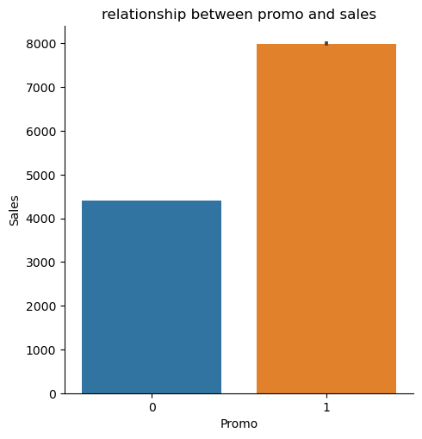
Relationship between promo and sales
There is a strong positive correlation between sales and customers indicating that higher customers lead to more sales. Promo leads to higher sales but do not necessarily mean increase in customers from as seen from the table below that when there are no promo (‘0’) the number of customers are higher.

Slide 6
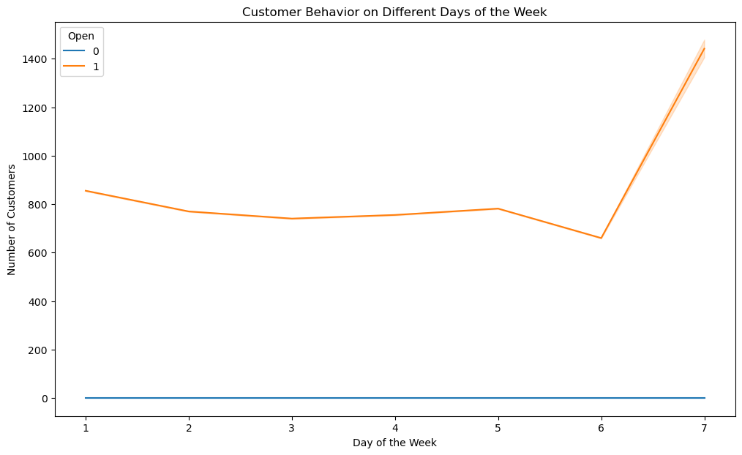
Trends of customer behavior during store open and closing times
Number of customers increase when the store is closed.

Slide 7
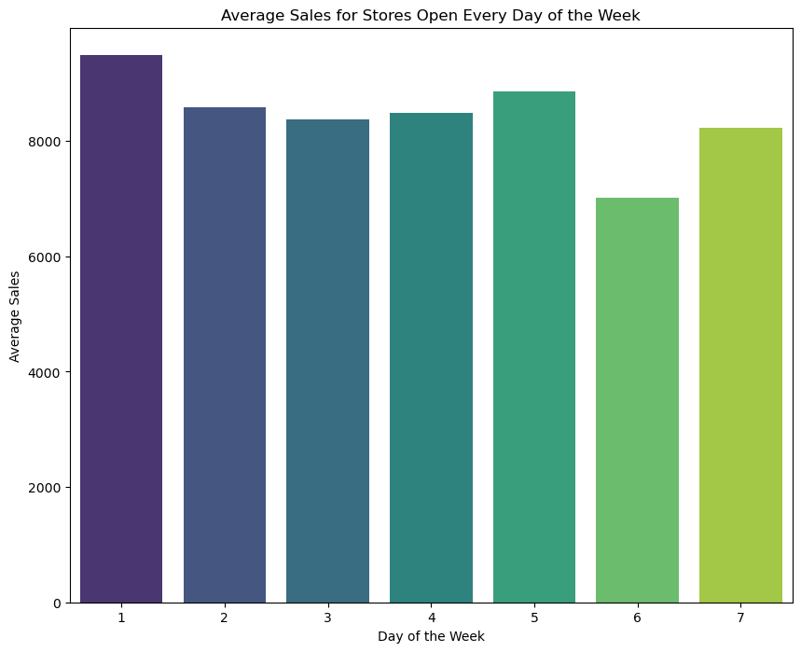
Average Sales for Stores Open Every Day of the Week
Insight :-> we have about 33 stores that work on all weekdays, and the sales on week ends show rise from Saturday to sunday

Slide 8
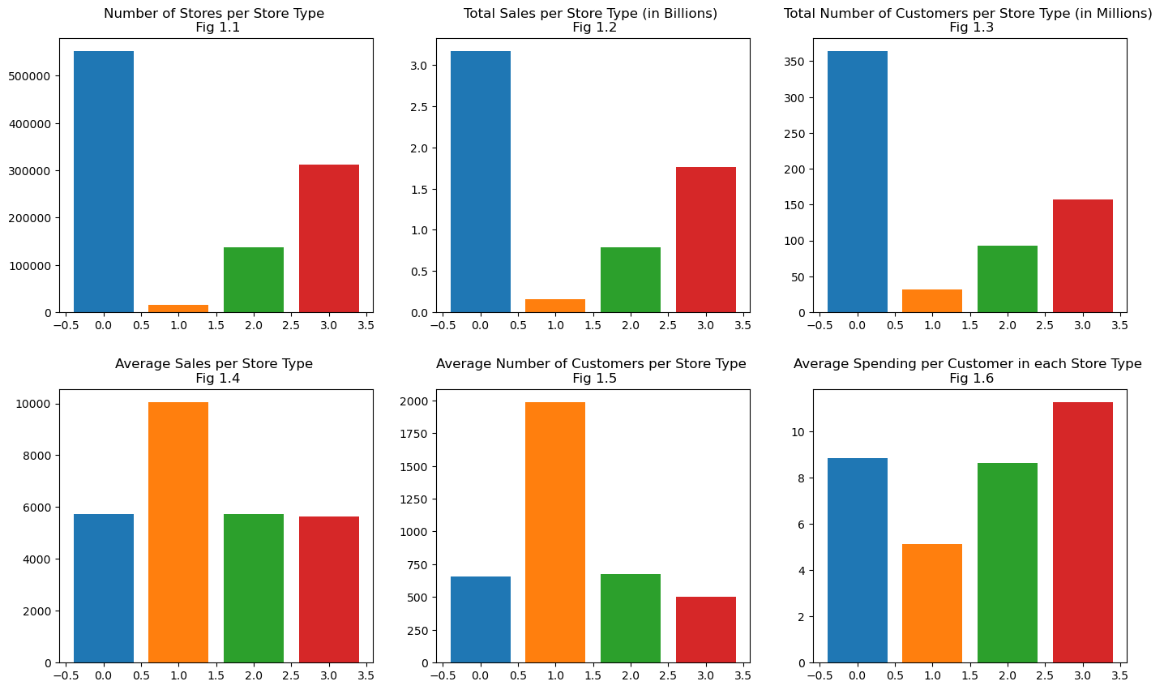
Total Sales Comparison

Slide 9
we can see that Storetype A has the highest number of branches , sales and customers from the 4 different storetypes. But this doesn't mean it's the best performing Storetype .
When looking at the average sales and number of customers, we see that actually it is Storetype B who was the highest average Sales and highest average Number of Customers. One assumption could be that if B has only 17 stores but such a high amount of average sales and customers that it is likely hyper Rossman branches whereas A would be smaller in size but much more present.
StoreType D who has the highest average spending per Customer, this is probably explained by an average competition distance higher than ther rest which means each customer will buy more since he knows there isn't a lot of similair shops around

Slide 10


